Slide 1
Scalable MVCC solution for
Many core machines
- Dilip Kumar (dilip.kumar@huawei.com)
Nirmala S (nirmalas@huawei.com)
Zhengxiaojin (zhengxiaojin@huawei.com)
Renchaoqian (renchaoqian@huawei.com)

Slide 2
Content
1
Multicore Scalability issue
2
Concept of MVCC
3
MVCC in PG
4
Lock Free CSN Solution
5
Conclusion

Slide 3
Multicore Scalability issue – TPCC test
For TPCC test using PG 9.4 on a machine with 120 cores, peak tpmc is hit at 25 terminals. After this increase in terminals reduces the performance. I/O and CPU are under utilized and maximum number of process are in idle state.

Slide 4
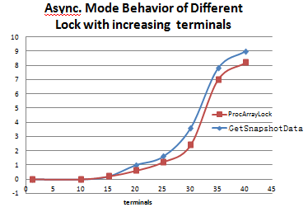
Multicore Scalability issue - Bottleneck Analysis
On analyzing stack for multiple concurrent terminals, it is evident that
ProcArrayLock contention is increasing with number of terminals. Contention starts increasing steeply after 30 terminals and stays in constant state. This lock accounts for 80% of contention in the whole system (GetSnaphsotData and ProcArrayEndTransaction)

Slide 5
Concept of MVCC
MVCC is a locking scheme commonly used by database implementations to control fast, safe and concurrent access to data.
MVCC is designed to provide following features for concurrent access
Readers do not block writers
Writers do not block readers
When an object has to be overwritten, it is marked obsolete and a new copy of it is written by the writer. Reader reads the current version and writer affects a future version of data. This ensures that readers do not block writers. Since writer is working on a different copy of data it does not block other readers.
MVCC is generally implemented using transactionID or some timestamp mechanism. This is stored in each tuple so at run time, a decision can be made on the visibility of the tuple for any user given SQL.

Slide 6
MVCC in PG
MVCC is implemented in PG using transactionID. Each tuple maintains a xmin(XID of transaction that created it) and a xmax (XID of transaction that deleted it). A snapshot is taken at the beginning of a SQL statement irrespective of the isolation level . The main purpose of taking a snapshot is to
highest-numbered committed transaction
Lowest-numbered running transaction
Transactions that are currently executing
Any tuple is said to be visible, if
If xmin is <= highest-numbered committed transaction and xmin does not present in running transaction list, means changes of xmin is visible
1. If tuple has Xmax and xmax of the tuple is > highest-numbered committed transaction or xmax present in running transaction list, means changes of xmax changes are not visible and tuple is visible.
2. If Tuple don’t have Xmax then its visible.

Slide 7
MVCC in PG
All other tuple are not visible to current SQL.
Transaction information for a backend is stored in a data structure named Pgxact which is protected by a latch(LWLock) named ProcArracLock.

Slide 8
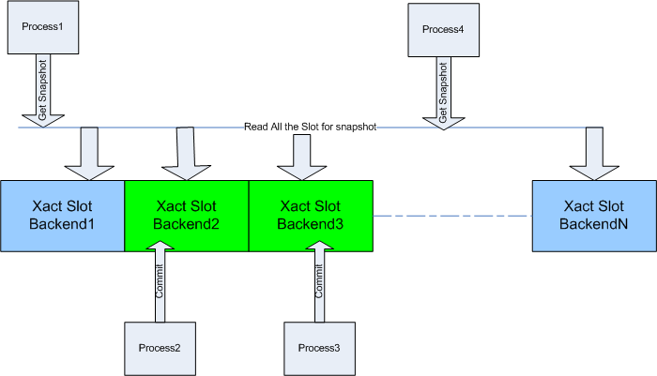
MVCC in PG
During snapshot creation, for getting all the running transaction information, a process takes Shared latch on ProcArrayLock (GetSnapshotData)
When a transaction is committing, it takes an exclusive latch on ProcArrayLock (ProcArrayEndTransaction) to update shared global variables.
When transactions – starting and ending try to use ProcArrayLock, contention ensues and scalability reduces.

Slide 9
Lock Free CSN solution
Main purpose of fetching all running transaction information is to know, which transaction committed before taking Snapshot and which after taking snapshot.
In order to remove bottleneck, it is necessary that either of GetSnapshotData or ProcArrayEndTransaction do not take latch. Since ProcArrayEndTransaction needs to update shared variables, removing latch is impossible.
Each transaction when committing, can increment a global number – CommitSequenceNumber(CSN). Any transaction which is starting, will note down the current CSN number of the system during its snapshot creation – this can be termed as SnapshotCSN.
Now to check the visibility of any tuple, it is enough to see if CSN associated with its xmin and xmax is less than SnapshotCSN.

Slide 10
Lock Free CSN solution
By effectively having an integer(CSN) which is shared across all backends, we can remove traversing Pgxact structure and thereby removing the need to acquire ProcArrayLock in shared mode.
One of the obvious problems for the CSN based solution is how to maintain a map between CSN and XID. This data structure should have the following properties
Searching should be efficient
Read/Write should be lock-free
We decided to select a circular array, in which we can directly get the XID slot using XID%ARRAY_SIZE. This ensures that there is no extra searching cost.

Slide 11
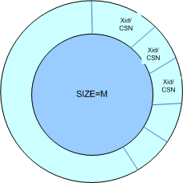
Lock Free CSN solution
XID to CSN mapping is stored in circular array called Dense Map.
Considering the high scalability in high end machines , size of the Dense Map is selected very high ~2GB which can hold almost 200Millions of transactions.
Basic assumption of keeping the size big is that when a slot has to reused because of % operation, the older XID may already be committed and its CSN value should be smaller than any active Snapshot CSN.
Each Slot maintain the Map b/w XID to CSN, XID slot can be accessed directly by XID%M
Size of This Circular Array is taken quite big ~2GB which can hold more than 200 Million transactions

Slide 12
Lock Free operations
Now major challenge is to keep the access to densemap lock free, b/w the reader (getting the CSN value for a transaction) and writer(reusing the slot and changing the transaction ID).
Writer
Writer will simply use the slot and overwrite the new XID without any lock.
Reader
Read Slot XID (Match XID with densemap Slot XID)
Read Slot CSN
Read Slot XID again (Rematch the XID, if matches than CSN value can be used. Otherwise some write has overwritten the XID, then start by reading CSN again)

Slide 13
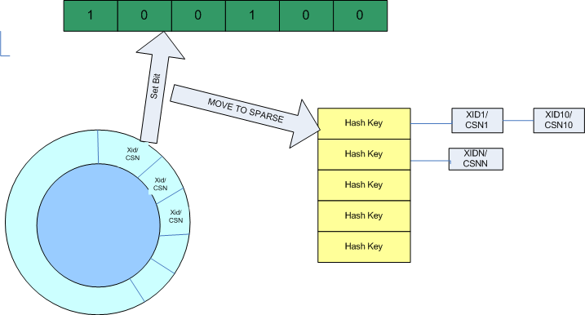
Overflow handling
Generally this scenario should happen very rarely.
But when happen we move such transaction to a secondary map, called sparse map. Sparse map is implemented using PG hash tables and has partition locks.
Writers of to the sparse map active exclusive locks, and reader take shared locks.
If a transaction is active, its XID should fall in either of densemap or sparsemap. If it is not found in both, then the transaction is visible to all active transaction.
When starting new transaction, If XID concurrent Move To sparse and Set a Bit

Slide 14
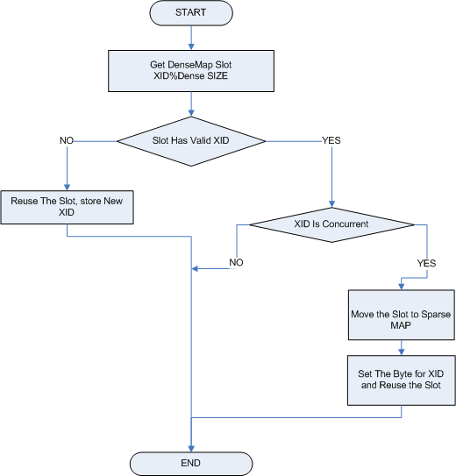
Lock free CSN – Start transaction
Get a slot for this Transaction from the dense MAP using XID % SIZE
If there is Old XID in Slot and its concurrent (either running or CSN is not smallest than global snapshot CSN min)
Move to Sparse Map
Take Sparse Map Lock
Copy Slot to Sparse Map
Release Lock
Set Bit for XID in XID Map
Reuse the Slot.

Slide 15
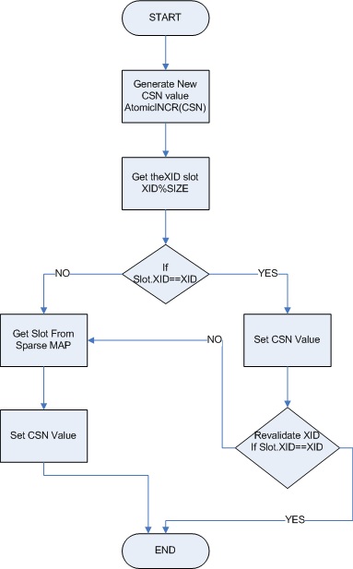
Lock free CSN – End Transaction
Get a slot for this Transaction from the dense MAP using XID % SIZE
Generate New CSN(Increment Global CSN value)
Assign SUB_CSN value to all sub transactions.
Assign CSN value to main transaction.
Assign CSN value to all sub transactions.
In case of abort Assign special CSN called ABORT_CSN.

Slide 16
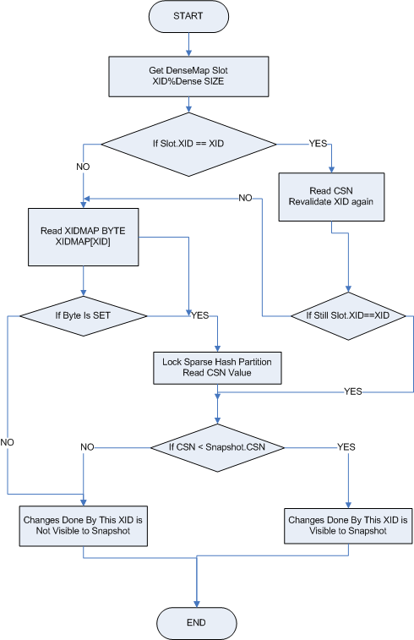
Lock Free CSN – Visibility Check
For checking a visibility of a operation done by transaction (XID), first find the slot for the XID, using XID%DenseMapSize.
If XID matches, read CSN value and check the XID again.
If XID not match then check the ByteMAP, if set than search in Sparse Map.
Compare the Slot CSN with Snapshot CSN
If Slot CSN > Snapshot CSN changes are not visible
Else Changes are visible.

Slide 17
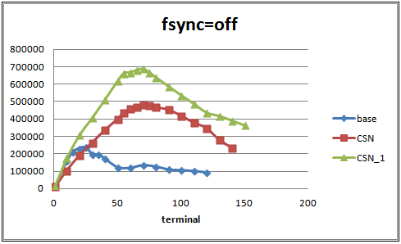
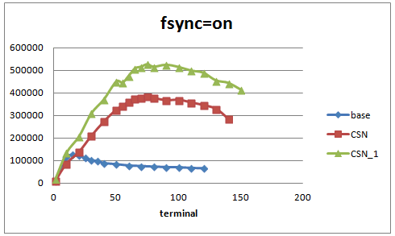
Lock free CSN - Performance Results
Performance Comparison of Lock Free CSN with Base Code in TPCC Test
base : Base code performance of PG9.4 with best configuration
CSN : Lock Free CSN code performance
CSN_1 : Lock Free CSN performance by configuration change
Result:
fsync=off, peak terminal=70 and peak tpmC=687,325, improve 191%
fsync=on, peak terminal=75 and peak tpmC=525,862, improve 316%

Slide 18
Conclusion
From last two experiment we can observe that now ProcArrayLock Bottleneck is completely removed from the system.
Now new bottlenecks are getting uncovered like bufferLocks, Clog Partition Locks.
This is clearly visible from TPCC experiment, where by changing some configuration , it can scale further, but same was not possible with base code as it was already hitting earlier bottleneck (ProcArrayLock).

Slide 19
Thank You

